Slide 1
Lecture 6
Strings in ASM – part II

Slide 2
String Characteristics for string instructions
Type of the elements
Bytes (B)
Words (W)
Address of the first element
in DS:ESI - for the source string
The parsing direction
from small addresses to large addresses -> DF=0 <-> CLD
from large addresses to small addresses -> DF=1 <-> STD
Doublewords (D)
in ES:EDI - for the destination string
The number of elements
Notes:
In assembly, when we talk about strings, we have to keep in mind the following:
The type - can be any data type from assembly (byte, word, doubleword).
Here it is an important to mention that for string instrctions, the type is given by the last letter of the instruction that is used (B=byte, W=word, D=doubleword)
The adress of the first element from the string;
The parsing directions and the numbers of element from each string.
The string instructions have all default operands and they work in the following pattern: they do something with the current element of the string(s) and they move to the next element in the string(s). In order to work with string instructions, we must initially:
set the offset of the source string in the ESI register
set the offset of the destination string in the EDI register
set the parsing direction of strings; if the Direction Flag DF has value 0 strings are parsed from left to right and if DF has value 1 strings are parsed from right to left. To set the DF, we use the STD instruction and to clear the DF, we use CLD instruction.
Some string instructions work only with the source string, some others work only with the destination string and some others work with both.
The number of elements is ussualy placed in ECX register.

Slide 3
Instructions for strings processing
LODS (Load from string)
Load memory addressed by ESI into the register
STOS (Store string data)
Store the register contents into memory addressed by EDI
MOVS (Move string data)
Copy data from memory addressed by ESI to memory addressed by EDI
CMPS (Compare strings)
Compare the contents of two memory locations addressed by ESI and EDI
SCAS (Scan string)
Compare the register to the contents of memory addressed by EDI
Notes:
Now let’s see the instructions for processing strings:
There are five groups of instructions working with data from/in memory as fallows: to load, to store, to move, to compare and to scan strings – but this scan also perform a particular comparison between the content of memory adresed by EDI register and the acumulator register
As we already saw on previos slide, the souce string works with ESI register and the destination string works with EDI register.

Slide 4
LODS - Load memory addressed by ESI into the accumulator register
LODSB - The byte from the address <DS:ESI> is loaded in AL
If DF=0 then inc(ESI), else dec(ESI)
LODSW - The word from the address <DS:ESI> is loaded in AX
if DF=0 then ESI:=ESI+2, else ESI:=ESI-2
LODSD - The double word from the address <DS:ESI> is loaded in EAX
If DF=0 then ESI:=ESI+4, else ESI:=ESI-4
Notes:
Each of the five group instruction has three subcategories based on data type.
Hence, for loads, we have:
1 byte from the memory adreesed by ESI is loaded in AL, and the ESI register is increased/decreased with 1.
1 word from the memory adreesed by ESI is loaded in AX, and the ESI register is increased/decreased with 2.
1 doubleword from the memory adreesed by ESI is loaded in EAX, and the ESI register is increased/decreased with 4.
To increment or decrement the ESI register depeneds of parsing direction.

Slide 5
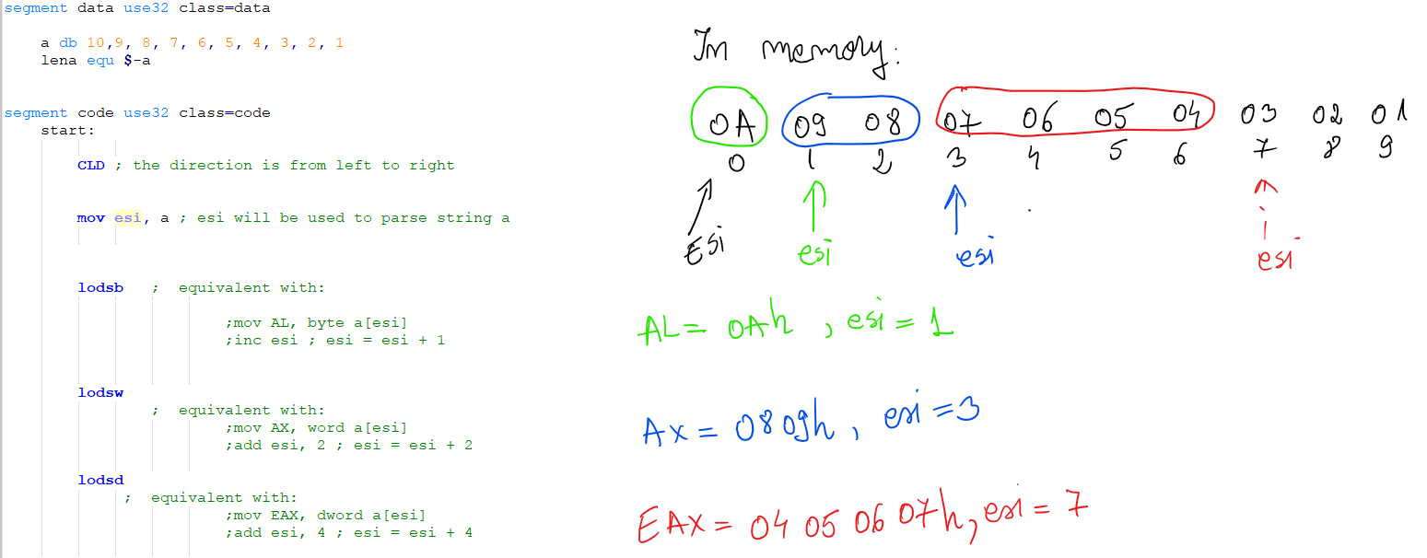
LODS and CLD

Slide 6
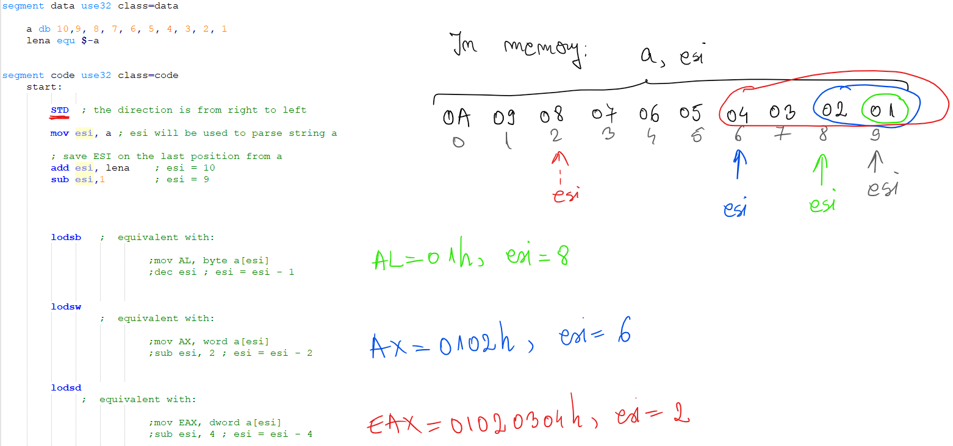
LODS and STD

Slide 7
STOS - Store the accumulator register contents into memory addressed by EDI
STOSB - Store AL into the byte from the address <ES:EDI>
If DF=0 then inc(EDI), else dec(EDI)
STOSW - Store AX into the word from the address <ES:EDI>
If DF=0 then EDI:= EDI+2, else EDI:= EDI-2
STOSD - Store EAX into the double word from the address <ES:EDI>
If DF=0 then EDI:= EDI+4, else EDI:= EDI-4
Notes:
Now, for store one string, we have:
Store String Byte – this save the content from AL register into memory adreesed by EDI register.
Store String Word – this save the content from AX register into memory adreesed by EDI register.
Store String Doubleword – this save the content from EAX register into memory adreesed by EDI register.
The EDI register is modified accordin to the parsing direction with 1, 2 or 4.

Slide 8
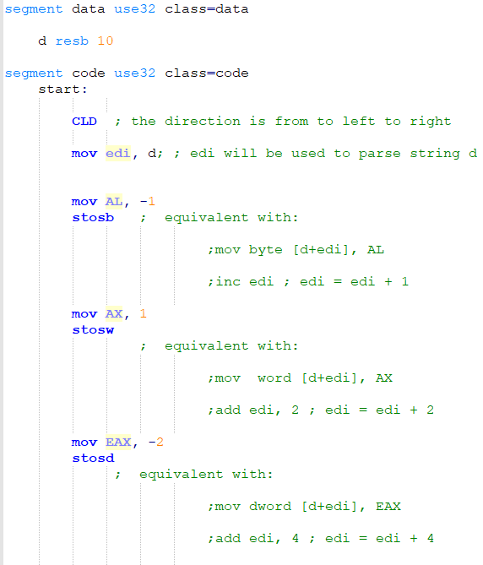
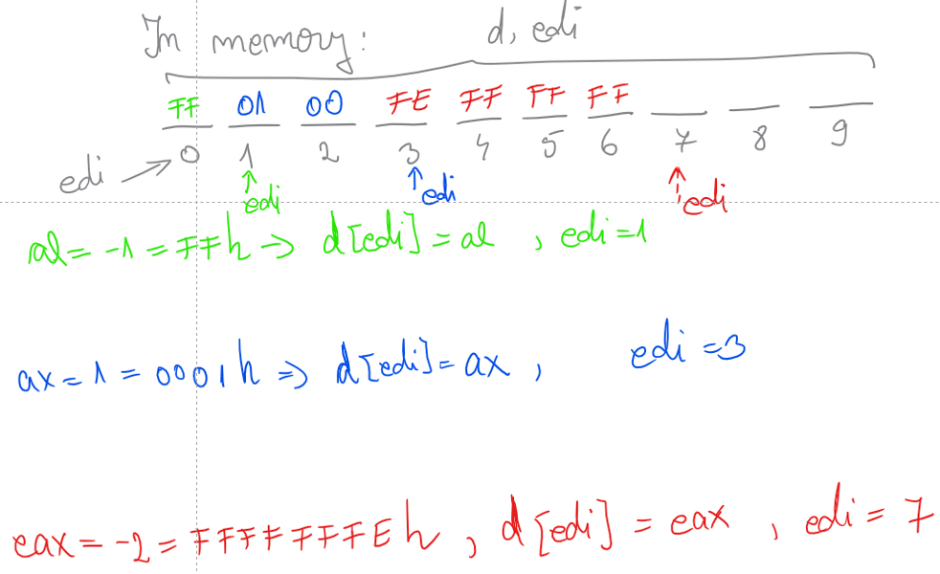
STOS and CLD

Slide 9
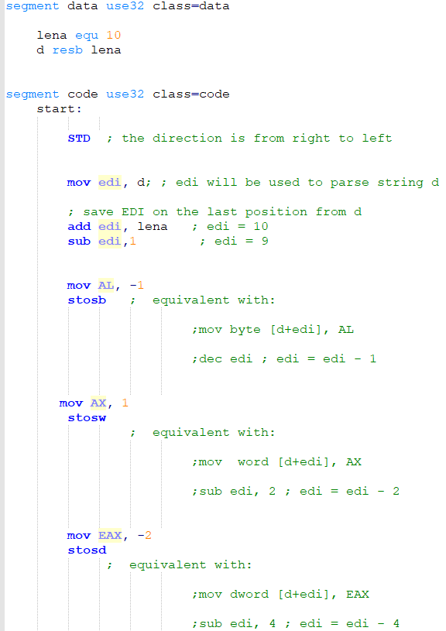
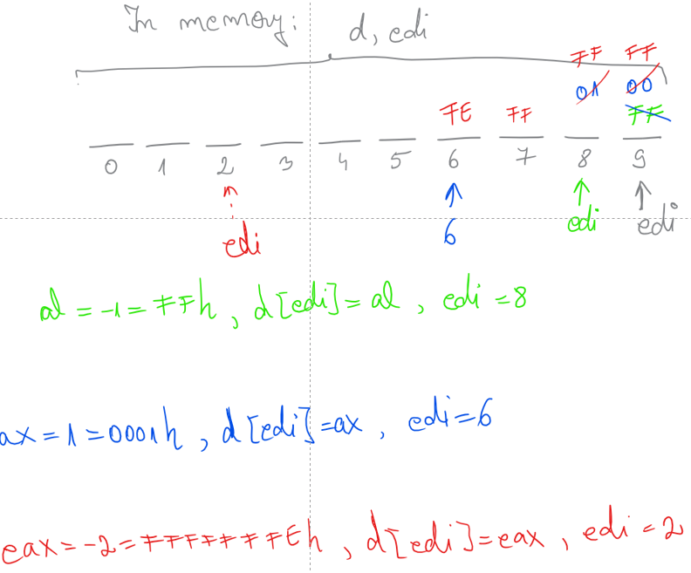
STOS and STD

Slide 10
MOVS - Copy data from memory addressed by ESI to memory addressed by EDI
MOVSB - Copy the byte from the address <DS:ESI> to the address <ES:EDI>
If DF=0 then inc(ESI), inc(EDI), else dec(ESI), dec(EDI)
MOVSW - Copy the word from the address <DS:ESI> to the address <ES:EDI>
If DF=0 then ESI:= ESI+2, EDI:= EDI+2, else ESI:= ESI-2, EDI:= EDI-2
MOVSD - Copy the doubleword from the address <DS:ESI> to the address <ES:EDI>
If DF=0 then ESI:= ESI+4, EDI:= EDI+4, else ESI:= ESI-4, EDI:= EDI-4
Notes:
The third group of instruction, Move String Data, perform a copy of content from the memory adreesed by ESI register in memory adressed by EDI.
One important observation here is that the parsing direction have to be the same because this group of instruction modified both registers in same way, can either increase or decrease, and the value of the modification is given by data type: 1 for byte, 2 for word and 4 for doubleword.

Slide 11
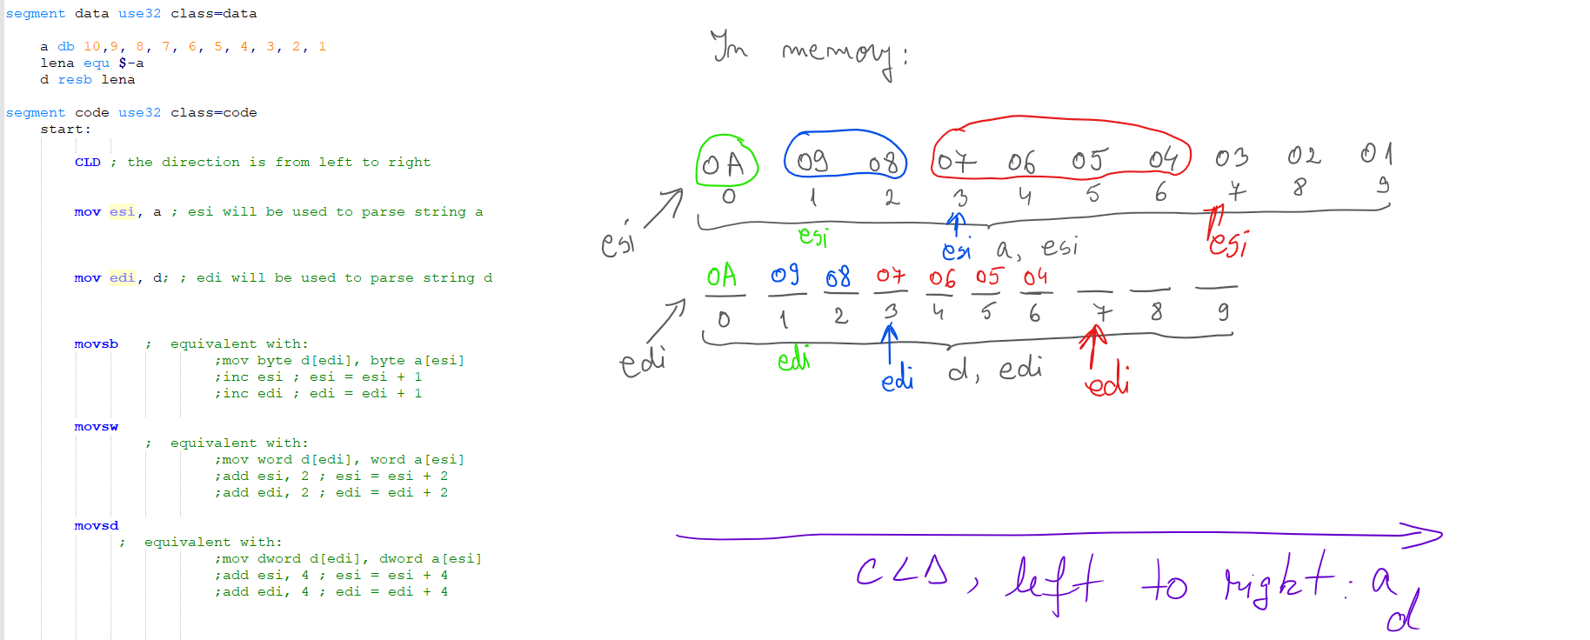
MOVS and CLD

Slide 12
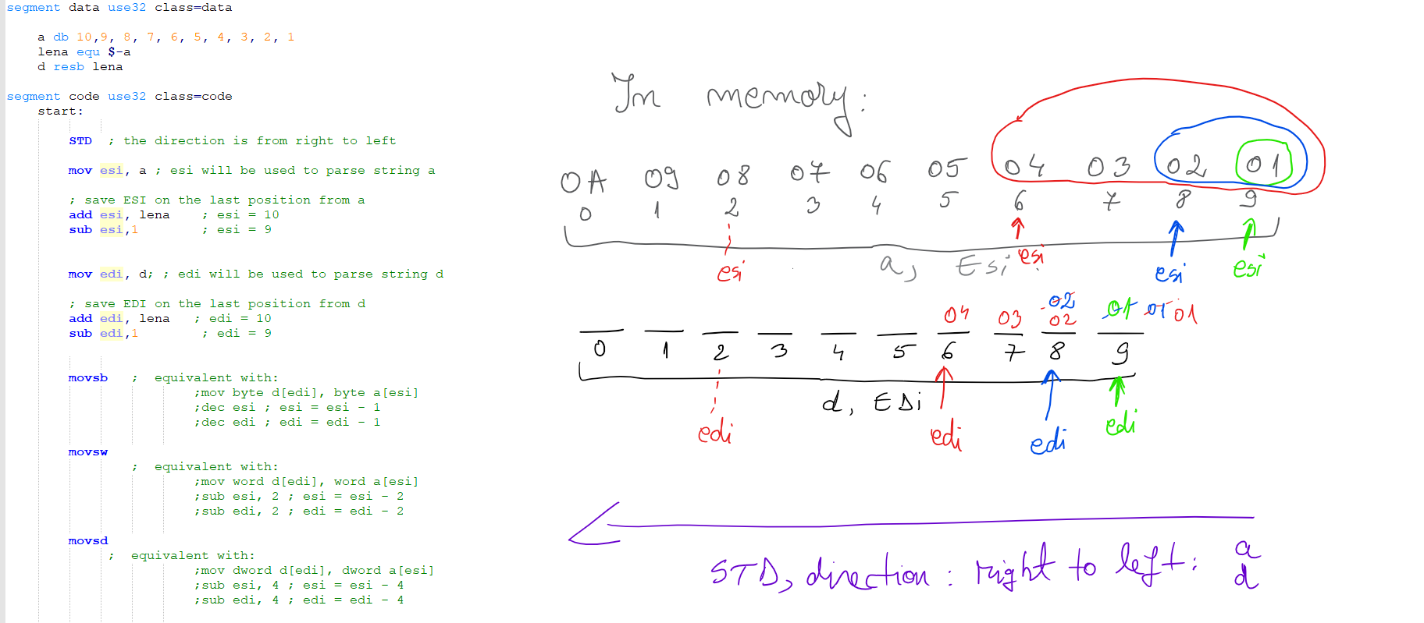
MOVS and STD

Slide 13
CMPS - Compare the contents of two memory locations addressed by ESI and EDI
CMPSB - Compare a byte from <DS:ESI> with a byte from <ES:EDI>
If DF=0 Then inc(ESI), inc(EDI), Else dec(ESI), dec(EDI)
CMPSW - Compare a word from <DS:ESI> with a word from <ES:EDI>
If DF=0 Then ESI:= ESI+2, EDI:= EDI+2, Else ESI:= ESI-2, EDI:= EDI-2
CMPSD - Compare a doubleword from <DS:ESI> with a doubleword from <ES:EDI>
If DF=0 Then ESI:= ESI+4, EDI:= EDI+4, Else ESI:= ESI-4, EDI:= EDI-4
Notes:
The Compare strings group works similar with the previous one, with the main difference that compare the content from the memory adressed by ESI with the content from memory addresed by EDI.
And here, the same observation: the parsing direction has to be the same.

Slide 14
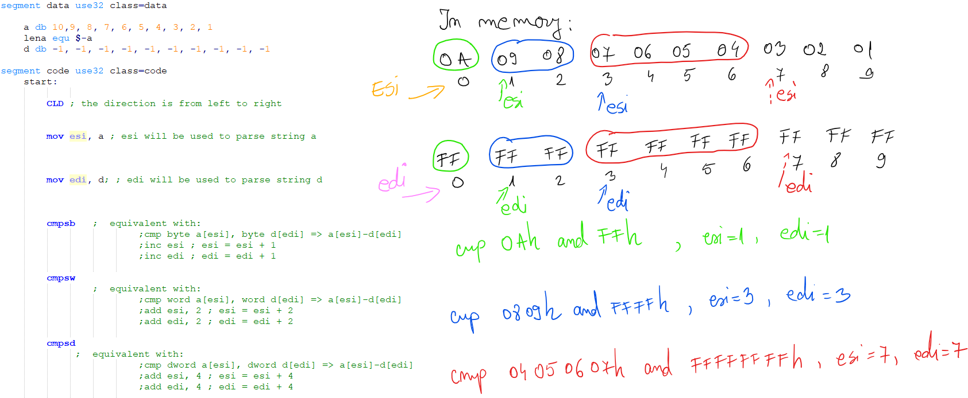
CMPS and CLD

Slide 15
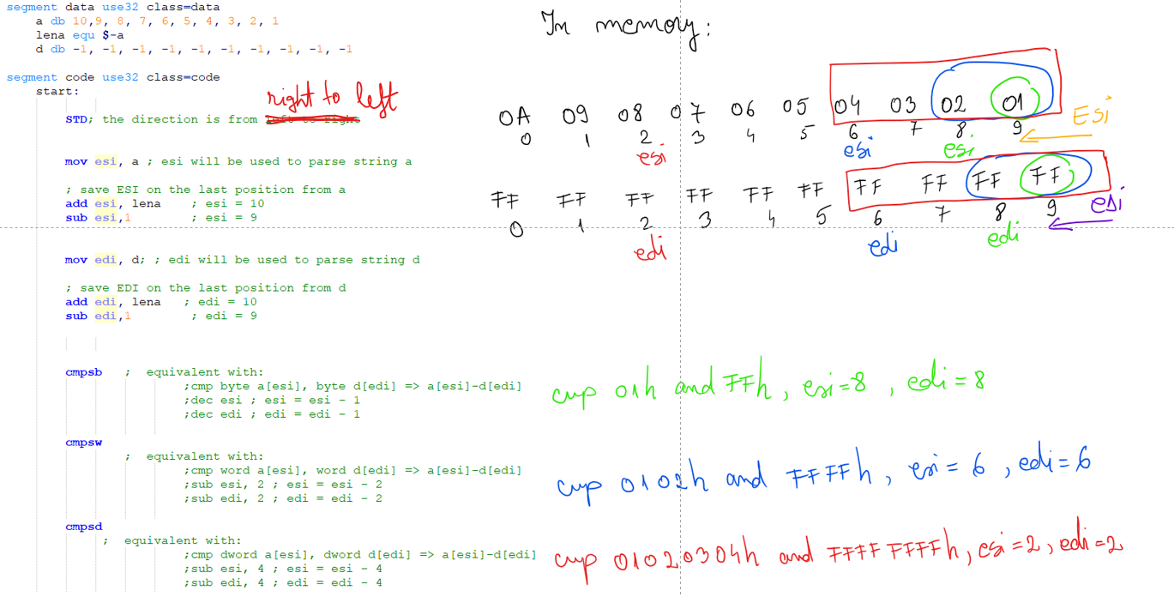
CMPS and STD

Slide 16
SCAS - Compare the accumulator register to the contents of memory addressed by EDI
SCASB - Compare AL with a byte from <ES:EDI>
If DF=0 then inc(EDI), else dec(EDI)
SCASW - Compare AX with a word from <ES:EDI>
If DF=0 then EDI:= EDI+2, else EDI:= EDI-2
SCASD - Compare EAX with a doubleword from <ES:EDI>
If DF=0 then EDI:= EDI+4, else EDI:= EDI-4
Notes:
The scan strings group perform also comparisons.
The value from the accumulator register is compared with the content from the memory adrresed by EDI.
The accumulator dimension and the change of EDI register is given by the laster letter meaning the type.

Slide 17
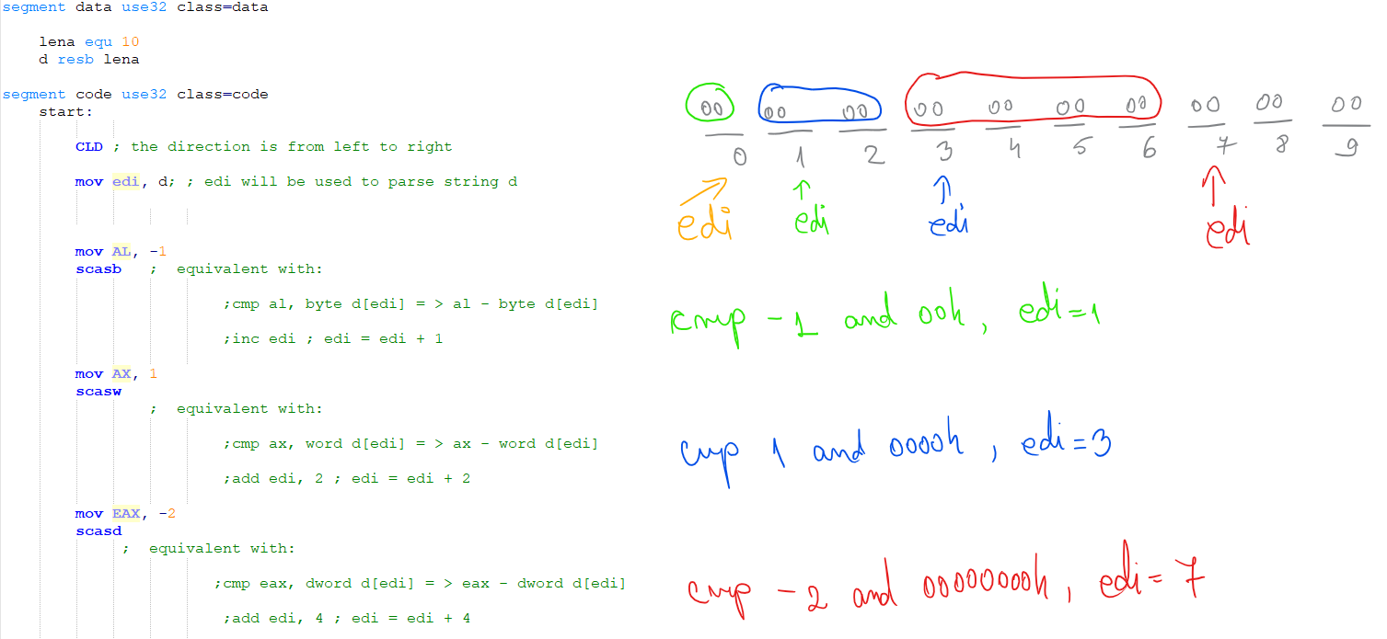
SCAS and CLD

Slide 18
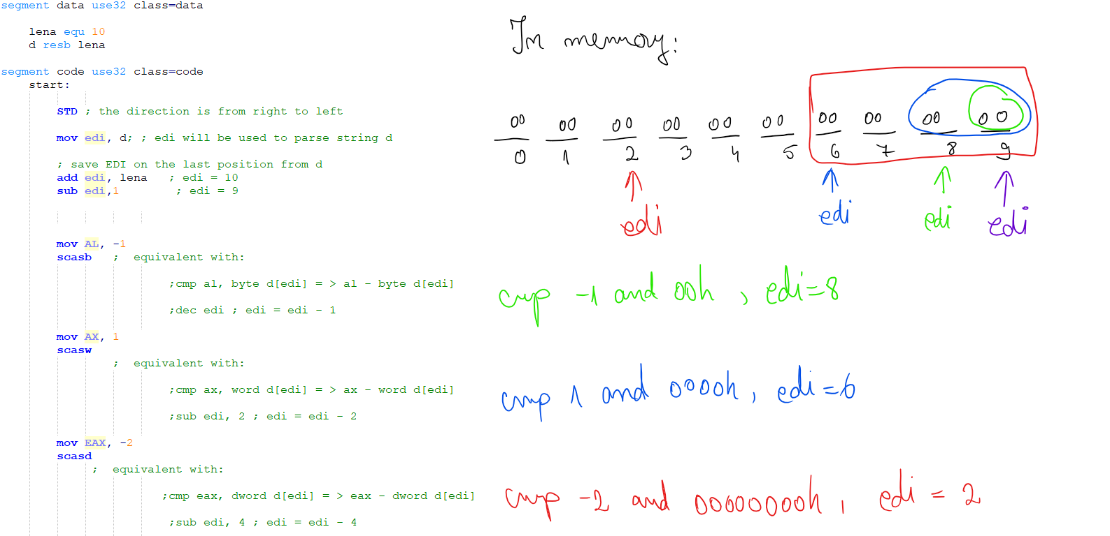
SCAS and STD

Slide 19
Repeat Prefix for string instructions
REP
Repeat while ECX > 0
REPZ, REPE
Repeat while the ZF=1 and ECX > 0
REPNZ, REPNE
Repeat while the ZF=0 and ECX > 0
Notes:
By itself, a string instruction processes only a single memory value or pair of values.
But, if we add a repeat prefix, the instruction repeats, using ECX as a counter. The repeat prefix allows us to process an entire string using a single instruction.
The following repeat prefixes are used:
REP: It is the unconditional repeat. It repeats the operation until ECX register becomes zero.
REPE or REPZ: It is conditional repeat. It repeats the operation while the zero flag indicates equal/zero. It stops when the ZF indicates not equal/zero or when ECX register is zero.
REPNE or REPNZ: It is also conditional repeat. It repeats the operation while the zero flag indicates not equal/zero. It stops when the ZF indicates equal/zero or when ECX is decremented to zero.

Slide 20
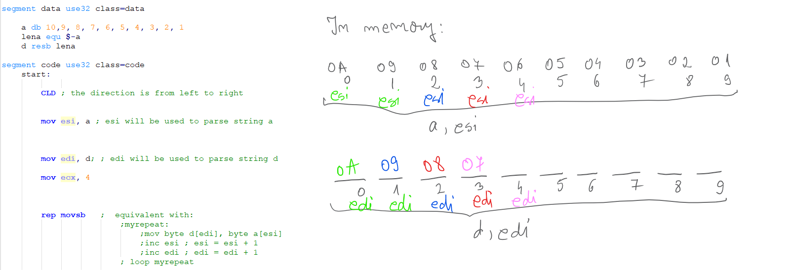
REP and CLD

Slide 21
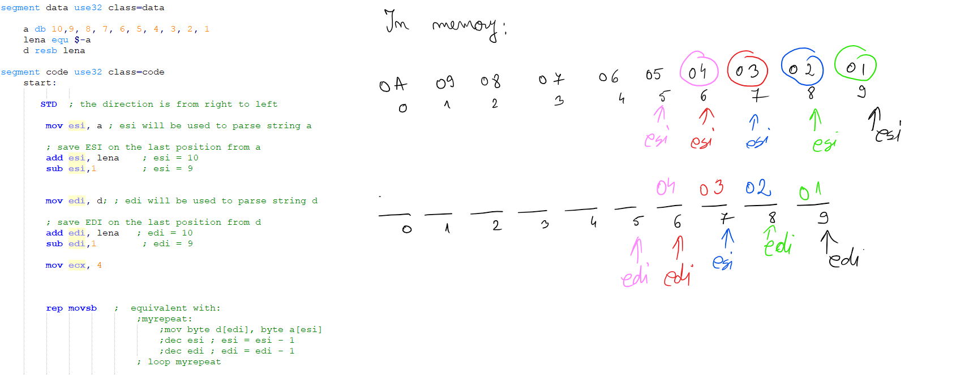
REP and STD

Slide 22
Examples A string of words (unsigned representation) is given in data segment. Copy the content in second string of words.
Without string instructions | With string instruction
segment data | segment data | segment data | segment data
source_str dw 1234h, 5678h | source_str dw 1234h, 5678h | source_str dw 1234h, 5678h | source_str dw 1234h, 5678h
len_str EQU ($-source_str)/2 | len_str EQU ($-source_str)/2 | len_str EQU ($-source_str)/2 | len_str EQU ($-source_str)/2
dest_str times len_str dw 0 | dest_str times len_str dw 0 | dest_str times len_str dw 0 | dest_str times len_str dw 0
segment code | segment code | segment code | segment code
mov ECX, len_str | mov ECX, len_str | mov ECX, len_str | mov ECX, len_str
mov ESI, 0 | mov ESI, source_str | mov ESI, source_str | mov ESI, source_str
mov EDI, 0 | mov EDI, dest_str | mov EDI, dest_str | mov EDI, dest_str
myRepeat:
mov AX, word[source_str+ESI] | CLD | CLD | CLD
mov word[dest_str+EDI], AX | myRepeat: | myRepeat:
add ESI, 2 | LODSW | MOVSW | rep MOVSW
add EDI, 2 | STOSW | LOOP myRepeat
LOOP myRepeat | LOOP myRepeat
Notes:
Now, we use an example to ilustrate a comparison between the approaches without and with string instructions.
In this moment after I say the requirement for the problem, I will ask students to share with me their idea to solving the problem.
So, in first column, we have the standard approach, we parse the given string, we acces each element and then, we save each element in the destination string.
We save the length of first string in ECX register and we use LOOOP instruction to parse the strings.
In second column we have the same approach but using string instrctions to save a word from memory (adresed by ESI) and move in memory adresed by EDI, lods and store. The instruction to set the parsing direction, from left to right (from small adrressed to large sdresses).
The third column combine loads and stos into movs one word and
In the last column the loop is replaced by repeat prefix. This one works similar but in few instructions.

Slide 23
A string of bytes (signed representation) is given in data segment.
Create two strings:
first string to contain only positive values from the initial string
second string to contain only negative values from the initial string.
Eg: if initial string = 1, -1, 0ah, 0fbh, 0fch, 3, 4
then:
p = 1, 0ah, 3, 4
n = -1, 0fbh, 0fch
Notes:
Here is the requiremnt for our problem.
Now, we start to debate posible solutions and decide which is suitable for us.
Ussualy I ask if someone want to come to write on the blackboard. In the end, the efort is rewarded with one star of activity.

Slide 24
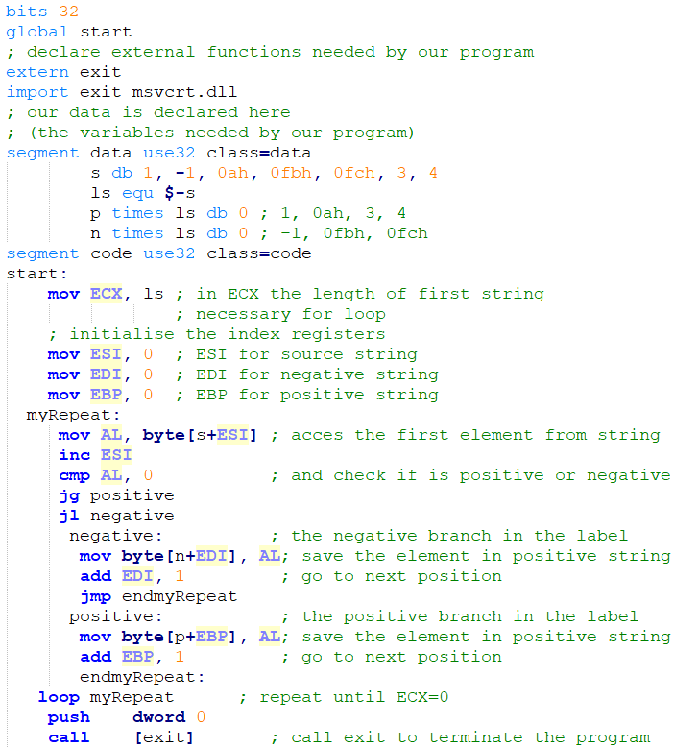
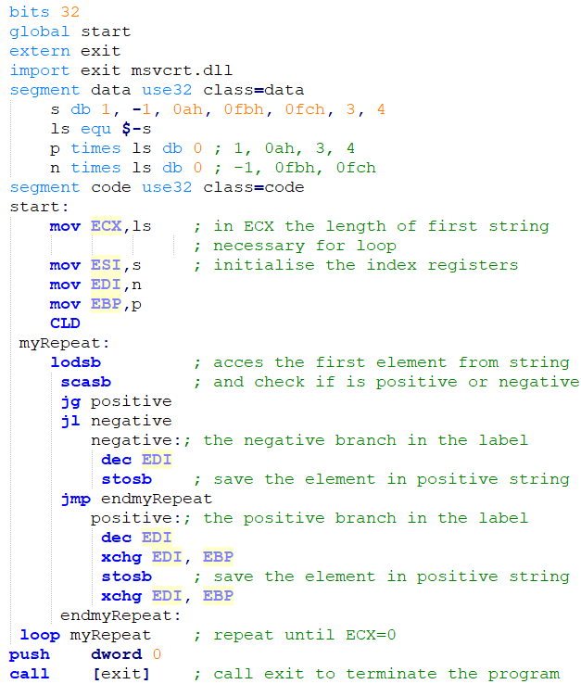
Without string instructions
With string instructions
Notes:
The solution.
In left part we have the standard approach, in which we acces each element from the string, we check if is positive or negative (the if condition and branches are realised in assembly with conditional jumps and labels) and we save the element in the corresponding string result.
To parse the strings we are using loop and, we have to pay attention at the index registers, ESI and EDI, both initioased at begining with 0, have to be increased manually.
In right part, the idea is the same, but using string instructions. In this case, the changes are from the begining: we initialise the index registers with the strings offset. We set the parsing direction. We acces elements from string using loads instruction and we check if is positive or negative using scan string byte (here we have to keep in mind the automatic change of the index registers (esi and edi incresead with 1).
To save elements in the coressponding strings, we use store instructions, stosb, having in mind the modification of the EDI register in scas (so, have to be decrease before iti is used in stos. And also, because we have three index registers here, we have to xchg values between edi and ebp.

